Slide 1

Way Maker

Slide 2
G D A Bm
G D
You are here, moving in our midst
A Bm
I worship You, I worship You
G D
You are here, working in this place
A Bm
I worship You, I worship You
to CHORUS

Slide 3
G
(You are) Way Maker, Miracle Worker
D
Promise Keeper
A
Light in the darkness, my God
Bm
That is who You are
repeat & to VERSE

Slide 4
G D
You are here, touching every heart
A Bm
I worship You, I worship You
G D
You are here, healing every heart
A Bm
I worship You, I worship You
to VERSE

Slide 5
G D
You are here, turning lives around
A Bm
I worship You, I worship You
G D
You are here, mending every heart
A Bm
I worship You, I worship You
to Chorus

Slide 6
G
(You are) Way Maker, Miracle Worker
D
Promise Keeper
A
Light in the darkness, my God
Bm
That is who You are
Repeat + go to TAG

Slide 7
G
That is who You are
D
That is who You are
A
That is who You are
Bm
That is who You are
Repeat + go to CHORUS

Slide 8
G
(You are) Way Maker, Miracle Worker
D
Promise Keeper
A
Light in the darkness, my God
Bm
That is who You are
Repeat + go to BRIDGE

Slide 9
G
Even when I don't see it, You're working
D
Even when I don't feel it, You're working
A
You never stop, You never stop working
Bm
You never stop, You never stop working
Repeat + go to CHORUS

Slide 10
G
(You are) Way Maker, Miracle Worker
D
Promise Keeper
A
Light in the darkness, my God
Bm
That is who You are
Repeat + go to TAG

Slide 11
G
That is who You are
D
That is who You are
A
That is who You are
Bm
That is who You are
Repeat + END

Slide 12
Shout to the LORD

Slide 13
G D G D
G D Em D C
My Jesus, my Savior, Lord there is none like You
G C G D
All of my days, I want to praise
Em F C Dsus D
The wonders of Your migh - ty love

Slide 14
G D
My comfort, my shelter
Em D C
tower of refuge and strength
G C G D
Let every breath, all that I am
Em F C Dsus D
Never cease to wor - ship You
To CHORUS

Slide 15
G Em C Dsus D
Shout to the Lord, all the earth let us sing
G Em C Dsus D
Power and majesty, praise to the King
Em D C
Mountains bow down, and the seas will roar
D Em D A
At the sound of Your Name

Slide 16
G Em C Dsus D
I sing for joy at the work of Your hands
G Em C Dsus D
For-ever I'll love You, For-ever I'll stand
Em D C Dsus D G
Nothing compares to the promise I have in You
To VERSE

Slide 17
G D Em D C
My Jesus, my Savior, Lord there is none like You
G C G D
All of my days, I want to praise
Em F C Dsus D
The wonders of Your migh - ty love

Slide 18
G D
My comfort, my shelter
Em D C
tower of refuge and strength
G C G D
Let every breath, all that I am
Em F C Dsus D
Never cease to wor - ship You
To CHORUS

Slide 19
G Em C Dsus D
Shout to the Lord, all the earth let us sing
G Em C Dsus D
Power and majesty, praise to the King
Em D C
Mountains bow down, and the seas will roar
D Em D A
At the sound of Your Name

Slide 20
G Em C Dsus D
I sing for joy at the work of Your hands
G Em C Dsus D
For-ever I'll love You, For-ever I'll stand
Em D C Dsus D G
Nothing compares to the promise I have in You

Slide 21
G Em C Dsus D
Shout to the Lord, all the earth let us sing
G Em C Dsus D
Power and majesty, praise to the King
Em D C
Mountains bow down, and the seas will roar
D Em D A
At the sound of Your Name

Slide 22
G Em C Dsus D
I sing for joy at the work of Your hands
G Em C Dsus D
For-ever I'll love You, For-ever I'll stand
Em D C Dsus D G
Nothing compares to the promise I have in You
END

Slide 23
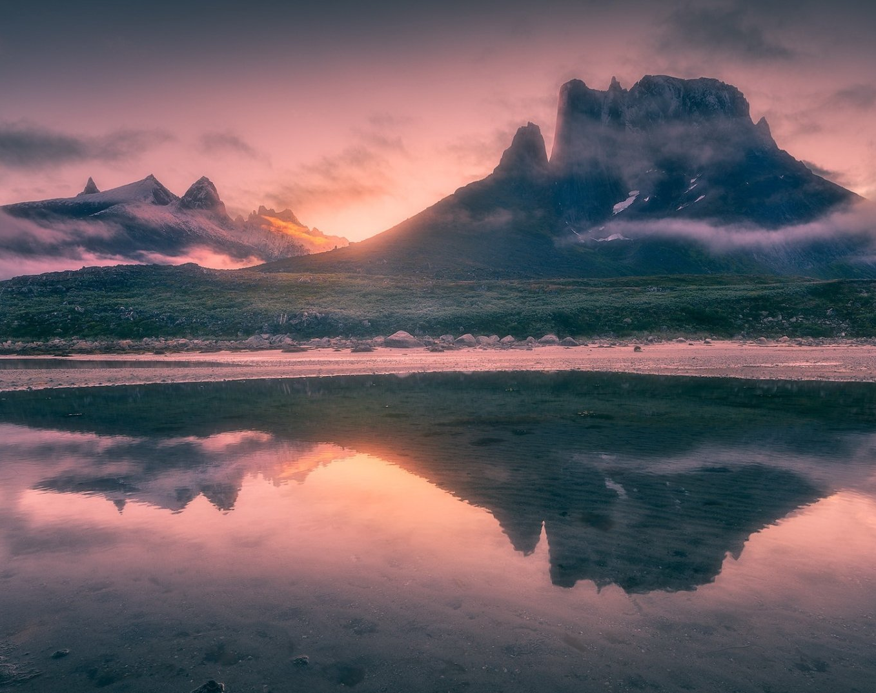
His Mercy is More

Slide 24
G C G Em D C G Em
Praise the Lord, His mercy is more
C D D Em
Stronger than darkness, new every morn
C G D G
Our sins they are many, His mercy is more

Slide 25
G
What love could remember,
C G
no wrongs we have done
D Em
Omniscient all-knowing,
C D
He counts not their sum

Slide 26
G Am
Thrown into a sea,
G C
without bottom or shore
C G
Our sins they are many,
D G
His mercy is more

Slide 27
G C G Em D C G Em
Praise the Lord, His mercy is more
C D D Em
Stronger than darkness, new every morn
C G D G
Our sins they are many, His mercy is more

Slide 28
G C G
What patience would wait as we constantly roam
D Em C D
What Father so tender is calling us home
G Am G C
He welcomes the weakest, the vilest, the poor
C G D G
Our sins they are many, His mercy is more

Slide 29
G C G Em D C G Em
Praise the Lord, His mercy is more
C D D Em
Stronger than darkness, new every morn
C G D G
Our sins they are many, His mercy is more

Slide 30
G C G
What riches of kindness He lavished on us
D Em C D
His blood was the payment, His life was the cost
G Am G C
We stood 'neath a debt we could never afford
C G D G
Our sins they are many, His mercy is more

Slide 31
G C G Em D C G Em
Praise the Lord, His mercy is more
C D D Em
Stronger than darkness, new every morn
C G D G
Our sins they are many, His mercy is more
REPEAT & END

Slide 32
How Great is Our God

Slide 33
G Em
The splendor of the King Clothed in majesty
C
Let all the earth rejoice All the earth rejoice
G Em
He wraps Himself in light And darkness tries to hide
C
And trembles at his voice Trembles at his voice
To CHORUS

Slide 34
G
How great is our God, sing with me
Em
How great is our God, all will see
C D G
How great, how great is our God
To VERSE

Slide 35
G Em
Age to age He stands And time is in His hands
C
Beginning and the end Beginning and the end
G Em
The Godhead, three in one Father, Spirit, Son
C
The Lion and the Lamb The Lion and the Lamb
To CHORUS

Slide 36
G
How great is our God, sing with me
Em
How great is our God, all will see
C D G
How great, how great is our God
To BRIDGE

Slide 37
G
Name above all names
Em
Worthy of all praise
C
My heart will sing
D G
How great is our God
x2 & chorus

Slide 38
G
How great is our God, sing with me
Em
How great is our God, all will see
C D G
How great, how great is our God
x2 End

Slide 39
Above All

Slide 40
CAPO 2nd
C D G
Above all powers, above all Kings
C D G
Above all nature, and all created things
Em D C G
Above all wisdom, and all the ways of man
Am D G
You were here before the world began

Slide 41
C D G
Above all kingdoms, above all thrones
C D G
Above all wonders this world has ever known
Em D C G
Above all wealth and treasures of the earth
Am C B
There's no way to measure what You're worth
To CHORUS

Slide 42
G Am D G
Crucified, laid behind a stone
G Am D G
You lived to die, rejected and alone
Em D C G
Like a rose, trampled on the ground
Am G C D G
You took the fall, and thought of me Above all
To VERSE

Slide 43
C D G
Above all powers, above all Kings
C D G
Above all nature, and all created things
Em D C G
Above all wisdom, and all the ways of man
Am D G
You were here before the world began

Slide 44
C D G
Above all kingdoms, above all thrones
C D G
Above all wonders this world has ever known
Em D C G
Above all wealth and treasures of the earth
Am C B
There's no way to measure what You're worth
To CHORUS

Slide 45
G Am D G
Crucified, laid behind a stone
G Am D G
You lived to die, rejected and alone
Em D C G
Like a rose, trampled on the ground
Am G C D G
You took the fall, and thought of me Above all
Play x2

Slide 46
Em D C G
Like a rose, trampled on the ground
Am G C D G
You took the fall, and thought of me Above all
END

